Slide 1
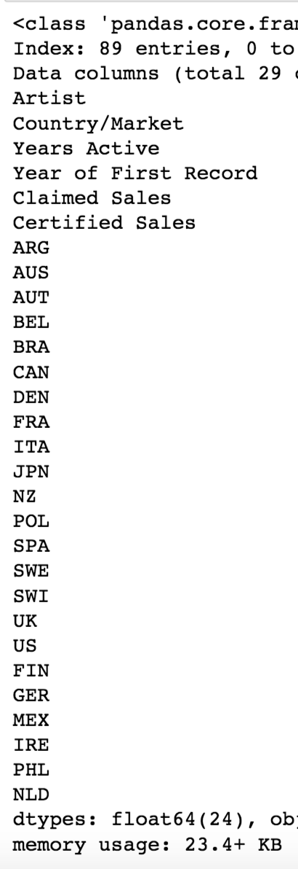
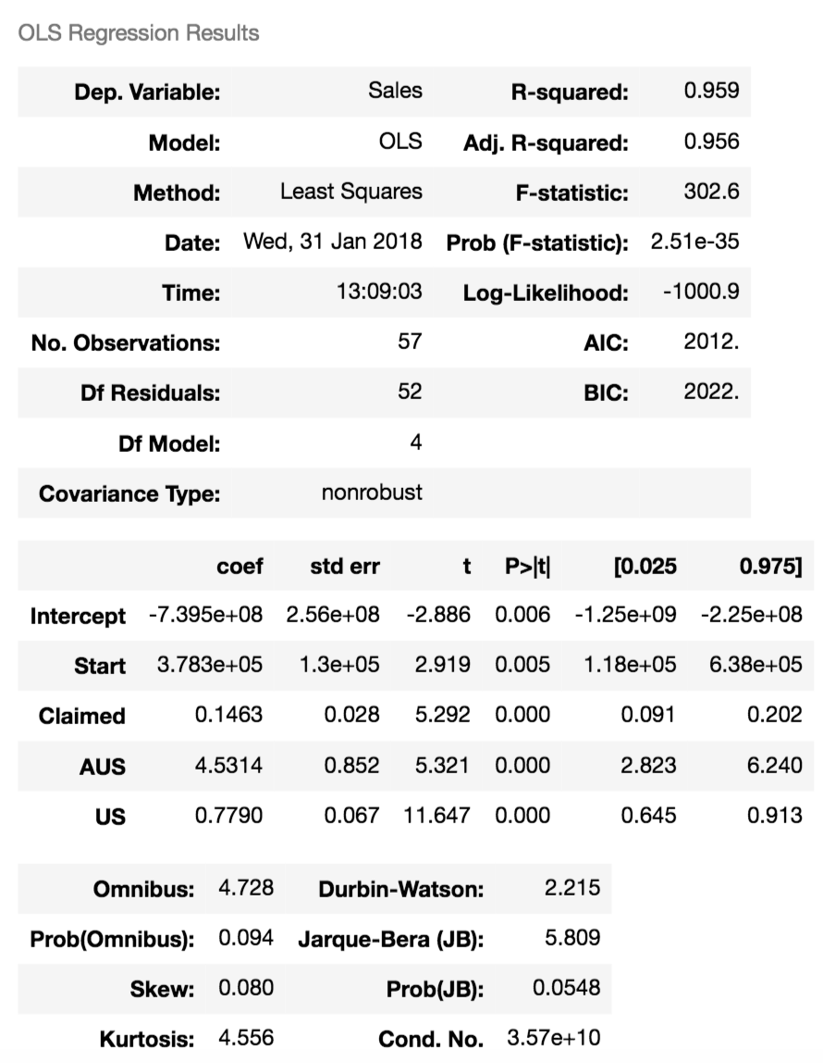
Predicting Success of Musicians:
How Many Albums
Will An Artist Sell
Globally?

Slide 2
